Slide 1




FPGA & Verilog
Hosted @
School of Electrical and Electronic Engineering; Uni. of Johannesburg
A short course on
presented by
Simon Winberg
Software Defined Radio Group (SDRG) University of Cape Town
November 2014

Slide 2
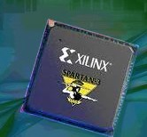

Outline of Lecture
FPGAs, their benefits and limitations
Programming and configuring FPGAs
Verilog vs VHDL (and some others)
Introduction to Verilog
Verilog Basics
Proceed to tutorial 1 (HDL coding & using Altera Quartus II™)

Slide 3
Programmable Chips
In comparison to hard-wired chips, a programmable chip can be configured according to user needs, providing a means to use the same chip(s) for a variety of different applications.
This facility makes programmable chips attractive for use in many products, including prototyping situations and final systems.
Further benefits are: low starting cost (eg. Web pack + dev kit), risk reduction, quick turnaround time

Slide 4
ASICs vs. Programmable Chips
Application Specific Integrated Circuit (or ASICs) have a longer design cycle and higher engineering cost than using programmable chips.
There is still a need for ASIC – such as faster performance and lower cost for high volume
Generally, programmable chips are suited to low to medium product production. (e.g. product runs needing under 10,000 chips)

Slide 5
PLAs, CPLDs and FPGAs
Programmable logic chips variety in terms simple→complex cheap→expensive
PLA = Programmable Logic Array
Simple: just AND and OR gates; but Cheap
CPLA = Complex PLA
Midrange: compose interconnected PLAs
FPGAs = Field Programmable Gate Array
Complex: programmable logic blocks and programmable interconnects; but Expensive
FPGA orders of magnitude larger than CPLD

Slide 6
Impressiveness of
FPGAs
1 Million+ Polygon Real Time Ray Tracing in Altera FPGA
High Resolution Real-Time Stereo Depth Map Estimation Using FPGA
+- 8 min

Slide 7
FPGA internal structure
Programmable logic element (PLE) (or FPLE*)
Image adapted from Maxfield (2004)
Note: one programmable logic block (PLB) may contain a complex arrangement of programmable logic elements (PLE).
The size of a FPGA or PLD is measured in the number of LEs (i.e., Logic Elements) that it has.
* FPLE = Field Programmable Logic Element

Slide 8
LUTs – a common ingredient
FPGA Programmable Logic Blocks (PLB) often comprise one or more LUT.
Similarly, programmable interconnects (PIs) are usually controlled via LUTs
Essentially, you could think of a FPGA as a type of memory device, since they often just comprise LUTs
But what is a LUT??

Slide 9
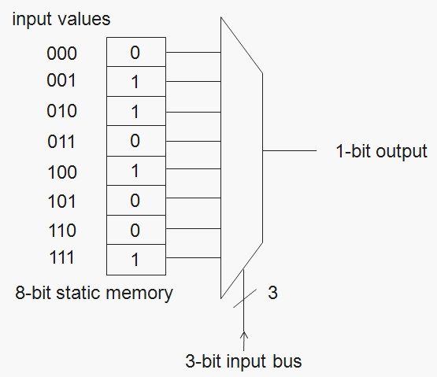
Look Up Table (LUT)
A look up table is basically a binary truth table. It has a set of input bits, and the LUT mechanism maps these to a set of output bits
e.g. F(010₂) = 1₂
F
Any guess as to what Boolean function this LUT is configured for?

Slide 10
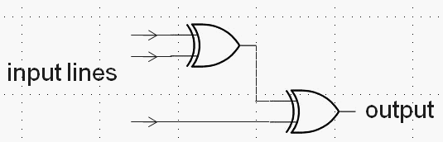
Look Up Table (LUT)
A look up table is basically a binary truth table. It has a set of input bits, and the LUT mechanism maps these to a set of output bits
e.g. F(010₂) = 1₂
F
ANSWER: It’s simply an XOR of all the inputs

Slide 11
Programmable Interconnect to PLB I/O as: LUT or MUXes
Programming lines
PLB
A
Inputs
B
LUT
or
MUX
C
PLB
D
. . .
A
B
LUT
or
MUX
Hopefully you can now easily see how the programming is going to happen…
C
D

Slide 12
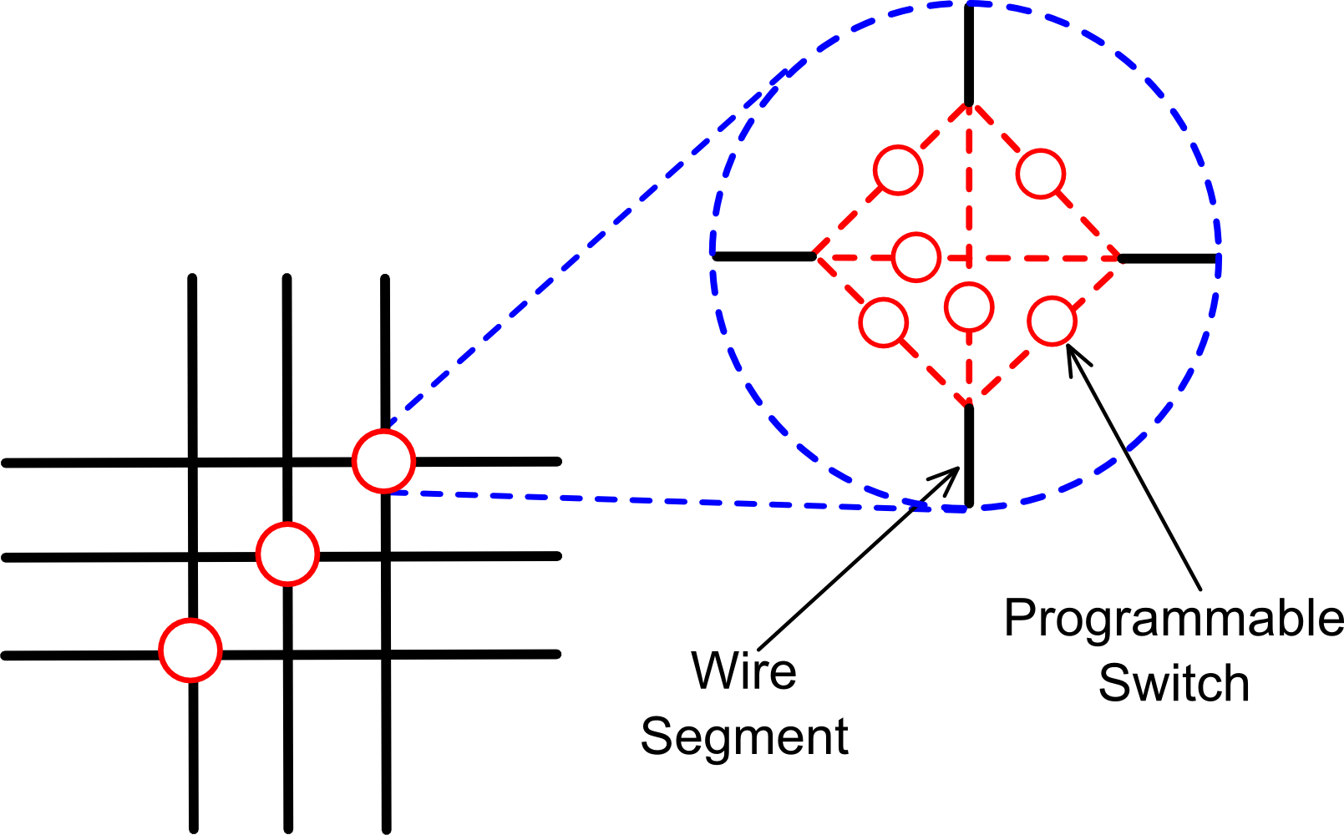
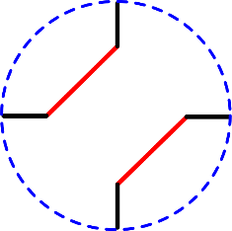
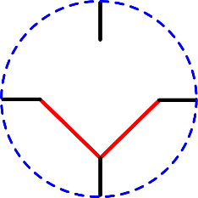
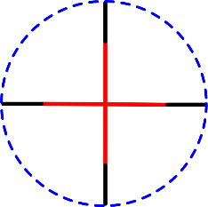
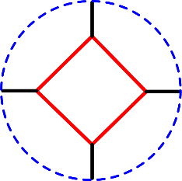
Programmable Interconnect: Switch Blocks
PLB
The switch block is an efficient particularly for implementing the routing at junctions inbetween PLBs, it allows for various configurations that the comparatively simpler multiplexer doesn’t provide* e.g.
Example Switch Block configurations:
left-top ,
right-bottom
Bottom- (right,left)
bottom-top , right-left
all
* Although ofcourse multiple MUXes could mimic this behaviour.

Slide 13
Programming FPGAs (simplified)
A
A
A
B
B
B
Inputs
Inputs
Inputs
C
C
C
Configuration Data
en
. . .
D
D
D
en
en
. . .
Configuration Control
. . .
111
000
001
PLB
PLB
110
010
. . .
101
011
100

Slide 14
Configuration Architectures
Configuration architecture =
The underlying circuitry that loads configuration data and places it at the correct locations

Slide 15
Configuration Architectures
Configuration architecture =
The underlying circuitry that loads configuration data and keeps it at the correct locations
CPU/ PC
creates bit file
Can store pre-configured bitmaps in memory
on the platform without having to send it each time
from the CPU. Include hardware for programming
the hardware (instead of the slower process of e.g.,
programming devices via JTAG from the host)
Configuration
protocol
Configuration
hardware
FPGA
Configuration Controller
Configuration
data
PROM (stores bit file)
Configuration
control
Adapted from Hauck and Dehon Ch4 (2008)

Slide 16
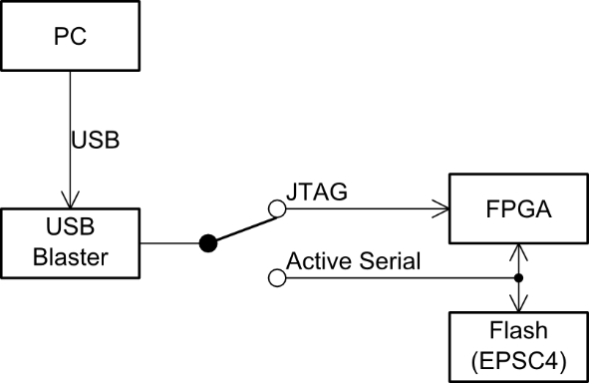
Configuration Architecture
Conceptual view of the DE0 configuration architecture
Programming…
Generate pof file,
Serializes the file to send over USB
DE0 board
run
prog
verify
CPLD that converts from USB stream to relevant protocol for JTAG/Flash
run/prog switch

Slide 17

So what? What is so special about FPGAs?
FPGA
A sea of possibilities…
…?
01001010101000100101001010010100 10010010010100100101101001 100100110101011010011101

Slide 18


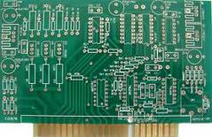


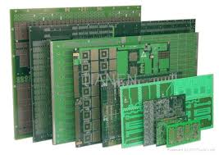
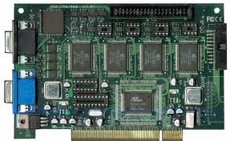
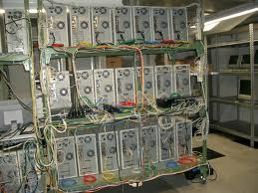




What is so special about FPGAs?
How CHPC uses FPGAs
How SDRRG uses FPGAs + Rhino
FPGA

Slide 19

What is so special about FPGAs?
How CHPC uses FPGAs
How SDRRG uses FPGAs + Rhino
Can put lots of electronic
stuff together in one place
FPGA

Slide 20

Any Drawbacks?
Here’s just a few drawbacks
Only does the digital part – still need analogue components, user interface, and interfacing circuitry that interacts with the outside world.
Has a limited number of IO pins that can connect up with external signals.
Susceptible to EM disturbances, PCB and other components needs to be suitably placed to avoid interfering with functioning of FPGA.
Typically a slower clock than most fast CPUs nowadays (e.g. 100MHz clock speed).
Eeek!
Often can’t achieve full utilization of PLBs
Typically has lots of pins that need to be soldered on, needing small track width and multilayer PCBs
Limitations of interconnects
Place & route can take a long time to run
A specialized form of development, combines the challenges of both s/w and h/w
Things can get rather… muddy

Slide 21
Onwards towards… FPGA Development Flow Verilog Basics and Altera Quartus II™ *
Since most of you have probably used Quartus II we won’t spent much time on that; but do let us know if Quartus II is new to you and would like help familiarizing yourself with it.

Slide 22
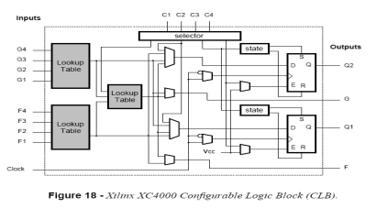
PLD/FPGA Development Flow
Design Specification
Design and RTL Coding
- Behavioral or Structural Description of Design - Writing VHDL, deciding i/o, formulating tests
RTL Simulation
- Functional Simulation
- Verify Logic Model & Data Flow
- View model-specified timing
LE
M512
Synthesis
- Translate Design into Device Specific Primitives
- Optimization to Meet Required Area & Performance Constraints
M4K
I/O
Place and Route (PAR)
- Map primitives to specific locations inside FPGA with reference to area & performance constraints
- Specify routing resources to use
This development cycle diagram is an adaptation of that prepared by Dr. Junaid Ahmed Zubairi,
… PTO …
Avail: http://www.cs.fredonia.edu/zubairi/training/fpga.ppt

Slide 23
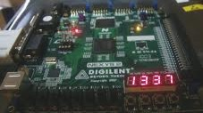
Development Flow
Place and Route (PAR)
t_{clk}
Timing Analysis
- Verify performance specifications
- Static timing analysis
Gate Level Simulation
- Timing simulation
- Verify design will work on target platform
Program and test on hardware
- Generate bit file - Program target device
- Activate the system

Slide 24



Development Flow: Where is most time spent?
Every development project is different. In my own experience, most of the time is probably spent…
Eish!
Design and RTL Coding
- Behavioral or Structural Description of Design - Writing HDL, deciding i/o, formulating tests
t_{clk}
Timing Analysis
- Verify performance specifications
- Static timing analysis
Engineer’s time
Eish!
Place and Route (PAR)
- Map primitives inside FPGA
- Specify routing resources to use
PC’s time

Slide 25

Verilog
VHDL

Slide 26

But first: the game of the names
Verilog
VHDL

Slide 27

VHDL Stands for…
Choose option below…
VHDL = VHSIC Hardware Description Language
VHDL = Verifiable Hardware Description Language
VHDL = Very High-level Description Language
(although you would be right to say that VHDL is a kind of very high-level description language)
Take a few seconds to think…
VHSIC = Very-High-Speed Integrated Circuit

Slide 28
Verilog stands for…
Choose option below…
Verilog = Very integrated logic
Verilog = Verifiable logic
Verilog = Verbatim interconnects and logic
(although you would be right to say that VHDL is a kind of very high-level description language)
Take a few seconds to think…

Slide 29
HDL Terms
Entity / module* – a basic building block of a design
Port – a connection or interface (argument list sometimes)
Behavior – description of operation of an entity
Structure – describes components/parts of an entity
Synthesis – conversion from HDL to gate level
Analysis – check design can be satisfied on device
Test Bench – tests to be done on entities
Simulation – validate design on simulated system
VHDL / Verilog equivalent terms

Slide 30
Terms and Keywords
Entity (in VHDL) = Module (in Verilog): designs are expressed in entities, these are components that are interfaced together via ports and maps
Architecture: Describes the behaviours of the entity. Each entity can have multiple architectures.
Configuration: binds a component instance to a entity-architecture pair
In Verilog one generally doesn’t implement separate architectural and behavioural modules, they can be expressed in the same module as needed.
Architecture
Entity (black box)
← Configuration ←
Ports
Source: Perry, D. 2002. VHDL Programming by Example. 4th ed. McDraw-Hill.

Slide 31
Important Terms
Top-level module: module at the top of the hierarchy
Package: collection of commonly used data types, subroutines, for implementing architectures
Driver: source on a signal
Bus: a signal that can have its sources turned off
Signal vector: what we usually think of as a bus
Attribute: data attached to VHDL objects (e.g., event status)
Generic: a parameter to pass information to an entity
Process: a basic unit of execution. Multiple processes are usually active at a time.
Source: Perry, D. 2002. VHDL Programming by Example. 4th ed. McDraw-Hill.

Slide 32
VHDL Example
Let’s implement this combinational logic circuit:
A
AND2
C
B
1-bit output
1-bit inputs
AND2 operation: C = A AND B

Slide 33
VHDL Example
Start by defining the entity:
-- Here’s a comment
library IEEE;
use IEEE.STD_LOGIC_1164.ALL;
entity AND2 is
port ( A : in STD_LOGIC;
B : in STD_LOGIC;
C : out STD_LOGIC );
end AND2;

Slide 34
VHDL Example
Then add an architecture:
Name of this architecture
…
architecture AND2bhv of AND2 is
begin
C <= A and B; -- The <= links signals and ports
end architecture;
As is the program should compile in Xilinx ISE; the system will create an instance of AND2 as it is the top level module, so no need to add an explicit configuration statement.

Slide 35
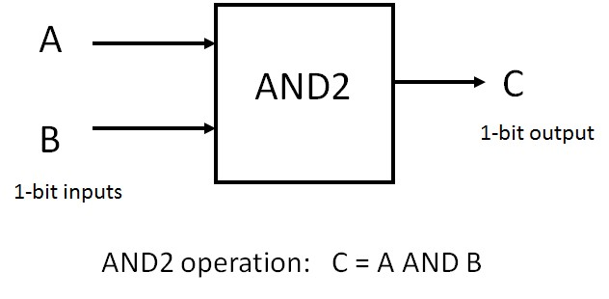
Verilog equivalent code
module AND2(A,B,C);
input A,B;
output C;
assign C = and(A,B);
endmodule
Alternatively:
module AND2(
input A,B,
output C);
// start the implementation:
assign C = A & B;
endmodule

Slide 36
Concurrent operation
Each statement in a HDL architecture block executes concurrently, whenever there is a change / event
e.g.
C <= and(A,B); -- executes when A or B changes
D <= or(A,B); -- executes when A or B changes
If A were to change (e.g. A changes from 0 to 1) then both the lines will execute at once)

Slide 37
Sequential operation (VHDL recap)
Sequential operation is described within a PROCESS block. Example:
-- single bit adder using sequential operation in VHDL
Library ieee; use ieee.std_logic_1164.all;
entity fulladder is
port (A1, A2, Cin: in std_logic;
sum, Cout : out std_logic );
end fulladder;
architecture arch1 of fulladder is
begin
process(A1,A2,Cin) -- define a sequential operation
begin
sum <= Cin xor A1 xor A2;
Cout <= (A1 and A2) or (Cin and (A1 xor A2));
end process;
end arch1;
VHDL
Style:
Sensitivity list (note not sensitive to Cout)
This line runs first
Then this line runs
Note: two process blocks in the same architecture block run concurrently

Slide 38
Sequential operation in Verilog
Sequential operation is described within a PROCESS block. Example:
// single bit adder using sequential operation in Verilog
module fulladder (input A1, A2, Cin,
output sum, Cout);
always @(A1,A2,Cin) begin
sum = xor(Cin,A1,A2);
Cout = or(and(A1,A2,and(Cin,xor(A1,A2))));
end
endmodule
Verilog
Style:
Sensitivity list (note not sensitive to Cout)
This line runs first
Then this line runs
Note: two always blocks in the same module will run concurrently
See how much less code in Verilog

Slide 39

Verilog coding
Best way to learn HDL is to practice coding with it. That’s what the tutorials are for.
See the Verilog Cheat Sheet included in resources

Slide 40
Verilog vs VHDL Syntax
Verilog
VHDL
More ‘concise’
Loosely typed
More susceptible to inadvertent bugs
Verilog signals and types:
wire a,b; wire [31:0]c; assign a = and(b,c); // saves some typing
Verilog sequential block:
always @ (a,b) begin … end
etc…
More ‘verbose’
Strongly typed
Less susceptible to inadvertent bugs
VHDL signals and types:
signal a, b : std_logic; signal c : ieee_int_ bla bla;
begin
a <= b and c;
end;
VHDL sequential block:
process (a, b) begin … end
etc…

Slide 41

End of
VHDL vs Verilog

Slide 42

Verilog
Taking something of a bottom-up approach, from hardware and RTL to top-level entity

Slide 43
Recommended Steps for HDL Design
Plan dataflow and code entities
Implement behaviours
Structural modelling (build complex entities using lower level ones)
Recommended online VHDL support:
http://www.asic-world.com/
Useful tutorials and examples on Verilog, System Verilog, SystemC, VHDL, others
http://esd.cs.ucr.edu/labs/tutorial/
This site provides a collection of useful VHDL example code and tutorials

Slide 44



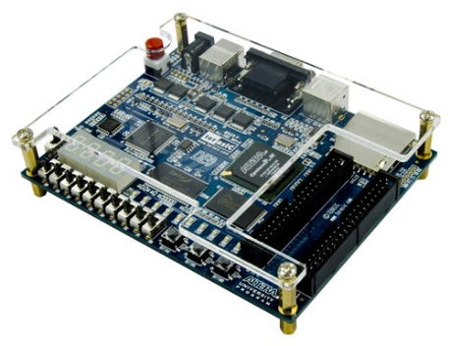
Verilog Overview
Welcome to Verilog and coding
Exercise
Verilog simulators
Intro to Altera Quartus II
history syntax
Basics of Verilog
iVerilog Simulation
Later running on h/w

Slide 45
Why consider Verilog?
VHDL and Verilog are both used as industry standards, sometimes interchangeably
VHDL is used quite widely in Europe (so is Verilog). Verilog used mostly in USA.
Easier to learn the syntax if you know C
Verilog is concise; but beware that it isn’t as strongly typed as VHDL so bugs can creep in

Slide 46

Lead in to Verilog…
History of Verilog
1980 Verilog developed by Gateway Design Automation (was initially their ‘secret weapon’)
1990 Verilog was made public
1995 adopted as IEEE standard 1364-1995
2001 enhanced version: Verilog 2001
2005: SystemVerilog
2009: New SystemVerilog standard

Slide 47
Module: Building block of Verilog Programs
…
module2
module1
Module: the basic block that does something and can be connected to (i.e. equivalent to entity in VHDL)
Modules are hierarchical. They can be individual elements (e.g. comprise standard gates) or can be a composition of other modules.
SYNTAX:
module <module name> (<module terminal list>);
…
<module implementation>
…
endmodule

Slide 48
Module Abstraction Levels
Switch Level Abstraction (lowest level)
Implementing using only switches and interconnects.
Gate Level (slightly higher level)
Implementing terms of gates like (i.e., AND, NOT, OR etc) and using interconnects between gates.
RTL / Dataflow Level
Implementing in terms of dataflow between registers
Behavioral Level
Implementing module in terms of algorithms, not worrying about hardware issues. Close to C programming.
High Level Synthesis (highest level)
Arguably the best thing about Verilog!!

Slide 49
Syntactic issues: Constant Values in Verilog
Number format:
<size>’<base><number>
Some examples:
3’b111 – a three bit number (i.e. 7₁₀)
8’hA1 – a hexadecimal (i.e. A1₁₆ = 161₁₀)
24’d165 – a decimal number (i.e. 165₁₀)
Defaults:
100 – 32-bit decimal by default if you don’t have a ‘
‘hab – 32-bit hexadecimal unsigned value
‘o77 – 32-bit octal unsigned value (77₈ = 63₁₀)

Slide 50
Syntactic issues: Constant Values in Verilog
Constant | Hardware Condition
0 | Low / Logic zero / False
1 | High / Logic one / True
x | Unknown
z | Floating / High impedance

Slide 51
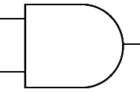
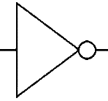
Wires
Wires (or nets) are used to connect elements (e.g. ports of modules)
Wires have values continuously driven onto them by outputs they connect to
// Defining the wires
// for this circuit:
a
c
d
Wire d;
wire a, b, c;
b

Slide 52
Registers
Registers store data
Registers retain their data until another value is put into them (i.e. works like a FF or latch)
A register needs no driver
reg myregister; // declare a new register (defaults to 1 bit)
myregister = 1'b1; // set the value to 1

Slide 53
Vectors of wires and registers
// Define some wires:
wire a; // a bit wire
wire [7:0] abus; // an 8-bit bus
wire [15:0] bus1, bus2; // two 16-bit busses
// Define some registers
reg active; // a single bit register
reg [0:17] count; // a vector of 18 bits

Slide 54
Data types
Integer 32-bit value
integer i; // e.g. used as a counter
Real 32-bit floating point value
real r; // e.g. floating point value for calculation
Time 64-bit value
time t; // e.g. used in simulation for delays
Genvar 32-bit value, like integer but generates multiple instances of the op see next slide

Slide 55
GenVar
MyModule MyModule_Instance (Reset,Clk,Output[0]);
MyModule MyModule_Instance (Reset,Clk,Output[1]);
MyModule MyModule_Instance (Reset,Clk,Output[2]);
MyModule MyModule_Instance (Reset,Clk,Output[3]);
MyModule MyModule_Instance (Reset,Clk,Output[4]);
MyModule MyModule_Instance (Reset,Clk,Output[5]);
MyModule MyModule_Instance (Reset,Clk,Output[6]);
MyModule MyModule_Instance (Reset,Clk,Output[7]);
MyModule MyModule_Instance (Reset,Clk,Output[8]);
MyModule MyModule_Instance (Reset,Clk,Output[9]);
MyModule MyModule_Instance (Reset,Clk,Output[10]);
MyModule MyModule_Instance (Reset,Clk,Output[11]);
MyModule MyModule_Instance (Reset,Clk,Output[12]);
MyModule MyModule_Instance (Reset,Clk,Output[13]);
MyModule MyModule_Instance (Reset,Clk,Output[14]);
MyModule MyModule_Instance (Reset,Clk,Output[15]);
MyModule MyModule_Instance (Reset,Clk,Output[16]);
MyModule MyModule_Instance (Reset,Clk,Output[17]);
MyModule MyModule_Instance (Reset,Clk,Output[18]);
MyModule MyModule_Instance (Reset,Clk,Output[19]);
genvar j;
wire [12:0]Output[19:0];
generate
for(j = 0; j < 20; j = j+1)
begin: Gen_Modules
MyModule MyModule_Instance (
Reset, Clk,
Output[j]
);
end
endgenerate

Slide 56
Verilog Parameters & Initial block
Parameter: a the rather obscurely named ‘parameter’ works more like a constant in C (or generic in VHDL)
Initial: used to initialize parameters or registers or describe a process for initializing a module (i.e. like constructor in C++)
Use both in implementation of a module

Slide 57
Ports
The tradition is to list output ports first and then input ports. This makes reading of code easier. i.e.:
ModuleName ( <output ports> <input ports>);
module mygate (
xout, // 1 bit output
clk , // clock input
ain ); // a 1 bit input
// define outputs
output xout;
// define inputs
input clk, ain;
… rest of implementation …
endmodule
mygate
clk
xout
ain

Slide 58
Register Output Ports
These are output port that hold their value. An essential feature needed to construct things like timers and flip flops
module mycounter (
count_out, // 8 bit vector output of the
clk ); // Clock input of the design
// Outputs:
output [7:0] count_out; // 8-bit counter output
// All the outputs are registers
reg [7:0] count_out;
// Inputs:
input clk;
…
endmodule

Slide 59
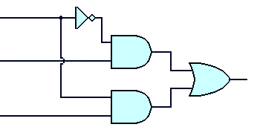
Instantiating modules and connecting up ports
These two tasks usually done in one go…
Modules are instantiated within modules
Syntax: <module name> <instance name> (<arguments>)
EXAMPLE:
// Multiplexer implemented using gates only*
module mux2to1 (a,b,sel,y);
input a,b,sel;
output y;
wire sel,asel,bsel,invsel;
not U_inv (invsel,sel);
and U_anda (asel,a,invsel),
U_andb (bsel,b,sel);
or U_or (y,asel,bsel);
endmodule
U_inv
sel
invsel
U_anda
asel
U_or
a
y
Module instance names
b
bsel
Port mapping (like arguments in a C function call)
U_andb
* Based on source: http://www.asic-world.com/code/hdl_models/mux_2to1_gates.v

Slide 60
Instantiating modules
Why give instances names?
In Verilog 2001 you can do:
module mux2to1 (input a, input b, input sel, output y);
…
and (asel,a,invsel), // can have unnamed instance
…
endmodule
Major reason for putting a name in is when it comes to debugging: Xilinx tends to assign instance names arbitrarily, like the and above might be called XXYY01 and then you might get a error message saying something like cannot connect signals to XXYY01 and then you spend ages trying to track down which gate is giving the problem.

Slide 61
Verilog Primitive Gates
Examples:
and
or
not
and a1 (OUT,IN1,IN2);
Can also
Use symbols:
&
|
~
not n1 (OUT,IN);
nand
nor
xor
Can also
Use symbols:
~&
~|
^
Buffer (i.e. 1-bit FIFO or splitter)
buf
Example:
buf onelinkbuf (OUT, IN);
buf twolinkbuf (OUT1, OUT2, IN);

Slide 62
BufIf (hardware if gate)
Tri-state buffer. Can choose to drive out with value of in (if ctr = 1) or don’t drive anything to out (i.e. if ctr = 0 connect high impedance to out)
in
out
bufif1 operation
ctr →
in →
ctr
 | 0 | 1 | x | z
0 | z | 0 | L | L
1 | z | 1 | H | H
x | z | x | x | x
z | z | x | x | x
bufif1 (out, in, ctr)
See also notif (works in the apposite way: if ctr=0 then drive out with in)

Slide 63
Verilog Recommended Coding Styles
Consistent indentation
Align code vertically on the = operator
Use meaningful variable names
Include comments (i.e. C-style // or /**/ )
brief descriptions, reference to documents
Can also be used to assist in separating parts of the code (e.g. indicate row of /*****/ to separate different module implementations)

Slide 64
Learning Verilog By Example

Slide 65
Where to go from here…
The preceding slides have given a very brief look at Verilog, but has covered much of the major things that are used most commonly.
It’s best to get stuck into experimenting and testing code in order to learn this language
Some thoughts for experimenting to do…

Slide 66
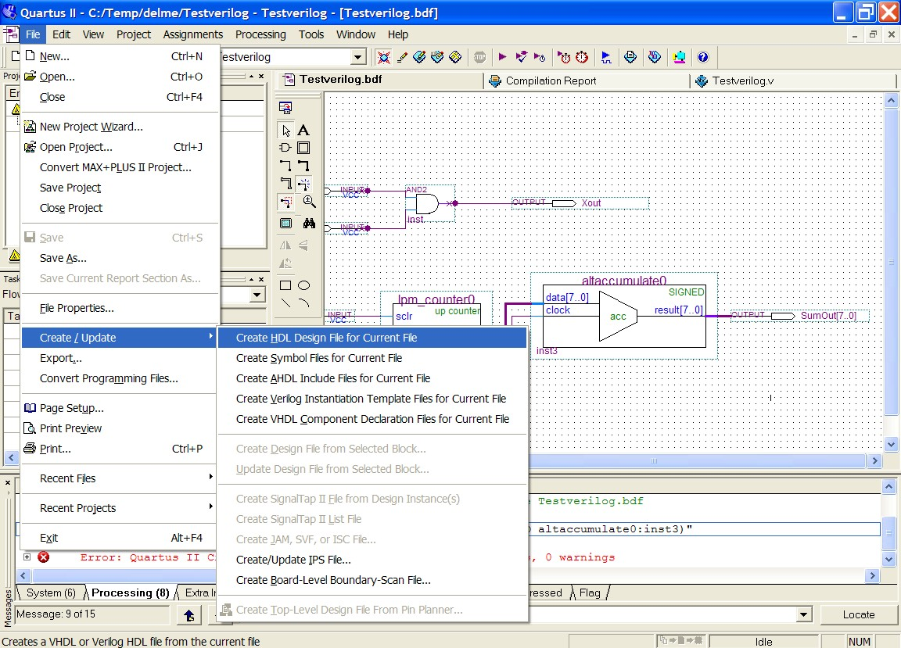
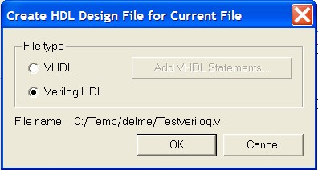
Learning Verilog
One approach is using a block diagram and converting to Verilog HDL.
E.g. using Altera Quartus II
(See test1.zip for example Quartus project)

Slide 67
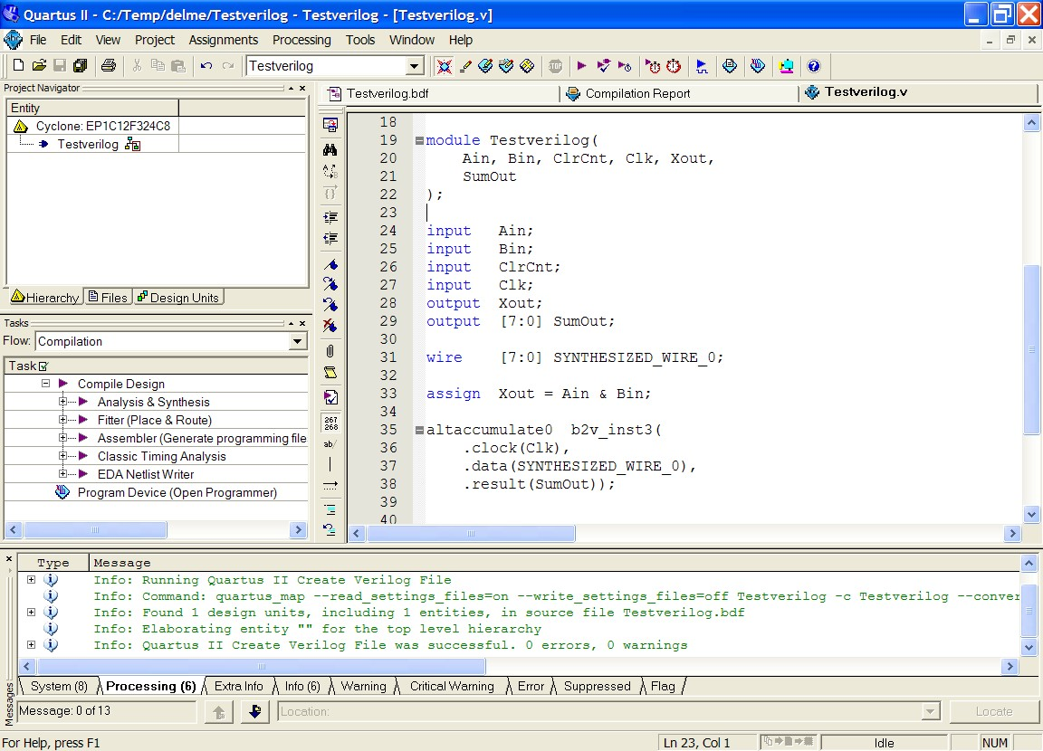
Learning Verilog
One approach is using a block diagram and converting to Verilog HDL.
E.g. using Altera Quartus II
See how param types are
specified
See how included modules are instantiated and ports mapped

Slide 68
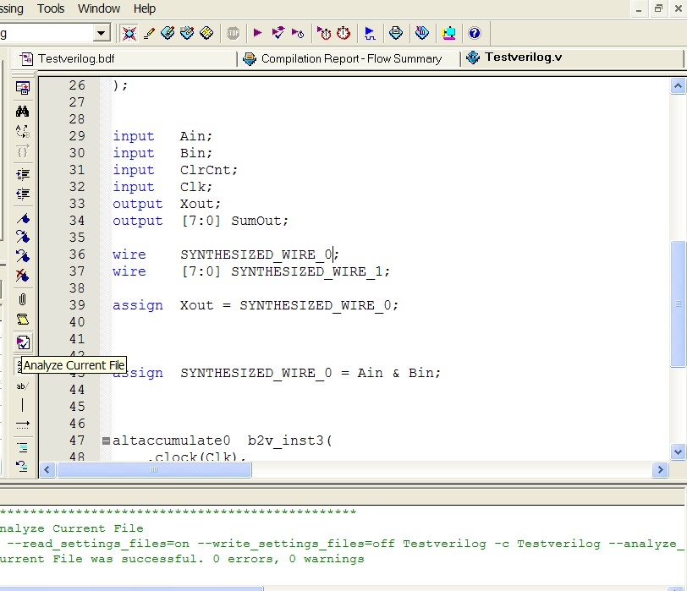
Checking syntax
I find a handy tool is the file analyser tool in Quartus II. This can be used to check the syntax of the file without having to go through the whole build process.

Slide 69
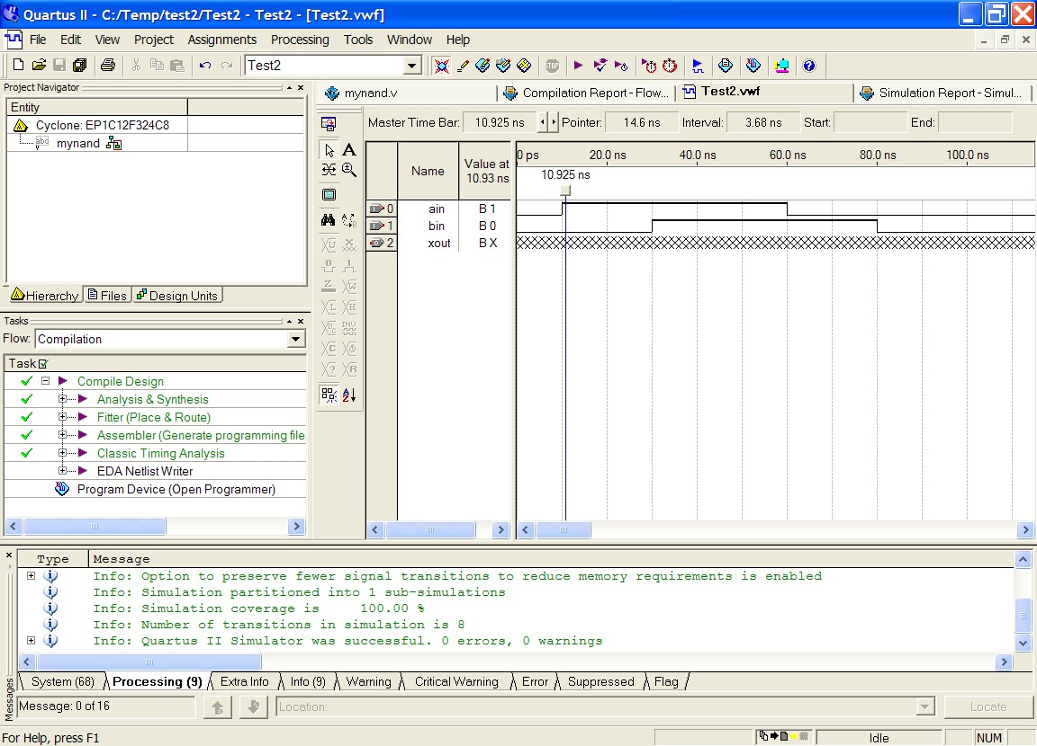
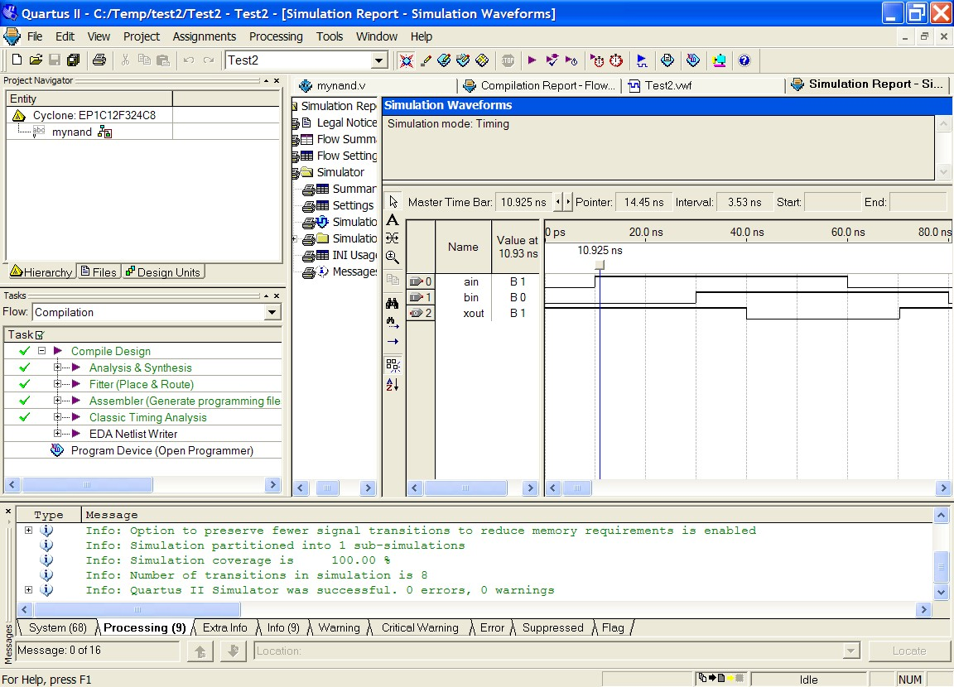
Testing
Running the simulation should allow you to verify the design is working as planned (i.e. NANDing)
Load the Test2 file, if using Quartus make sure that mynand is the top level Entity

Slide 70

Suggested study ideas…
See Verilog tutorials online, e.g.:
http://www.verilogtutorial.info/
Icarus Verilog – An open-source Verilog compiler and simulator
http://iverilog.icarus.com/
Try iverilog on forge.ee
Gplcver – Open-source Verilog interpreter
http://sourceforge.net/projects/gplcver/
Try cver on forge.ee
Verilator – An open-source Verilog optimizer and simulator
http://www.veripool.org/wiki/verilator
Comprehensive list of simulators:
http://www.asic-world.com/verilog/tools.html

Slide 71
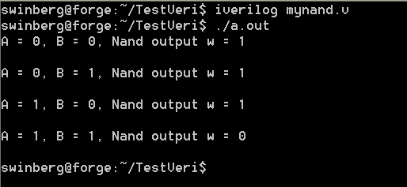
Icarus Verilog
Probably the easiest free open-source tool available
Excellent for doing quick tests.
Takes very little space (a few megs) & runs pretty fast.
Installed on forge.ee
For Ubuntu or Debian you can install it (if you’re linked to the leg server), using: apt-get install iverilog
Iverilog parsing the Verilog code and generates an executable the PC can run (called a.out if you don’t use the flags to change the output executable file name)
I suggest the following to get to know iverilog… upload mynand.v example to forge.ee, compile it with iverilog. Run it. Try changing the testbest code, put in some more operations
http://iverilog.icarus.com/

Slide 72
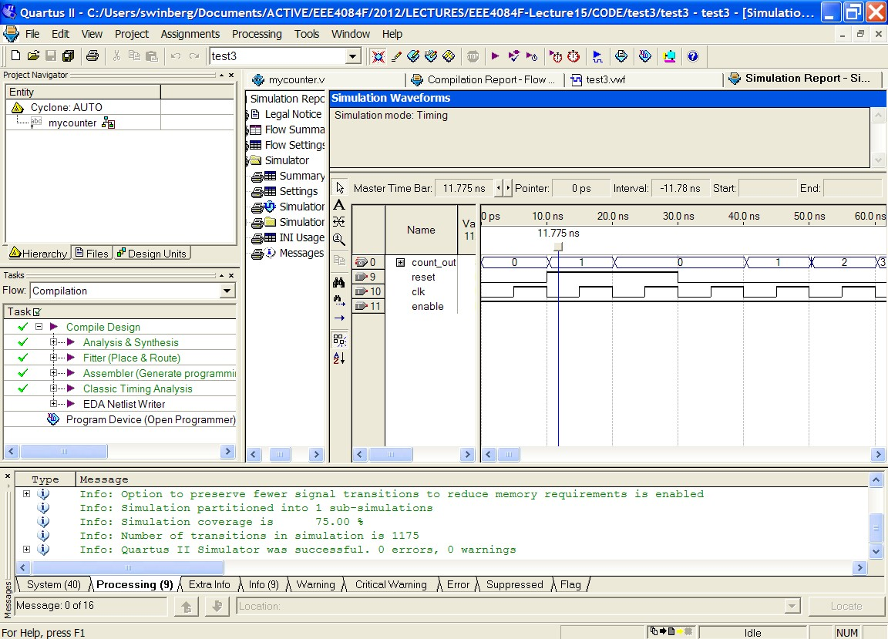
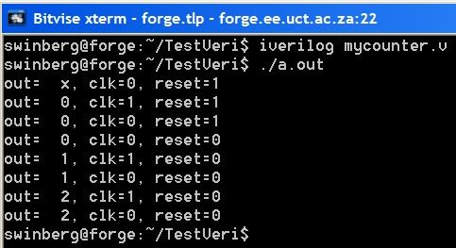
More Experimenting
Try test3 or mycounter.v as a more involved program and test
Experiment with using both Altera Qauartus II, Icarus Verilog, and Xilinx ISE ISim

Slide 73
Tutorial

